Slide 1
Review

Slide 2
Supervised Learning
Input
Output
Function
Data
Data
Input
Function
Output
x
f(x)
y

Slide 3
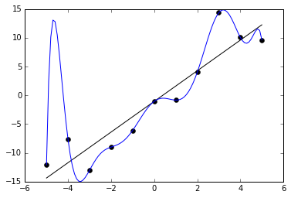
Predictive Generalization
Training Data
Test Data
Generalization
Overfitting

Slide 4


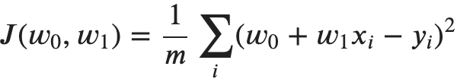

Optimization by Gradient Descent
Model
Parameters
Loss
Objective

Slide 5


Adding Complexity with Layers
Model
Parameters
Loss
Objective
b₁
b₃
x₁
w⁰₁₁
h₁
w¹₁₁
w⁰₂₁
y
w⁰₁₂
w¹₂₁
x₂
w⁰₂₂
h₂
b₂

Slide 6
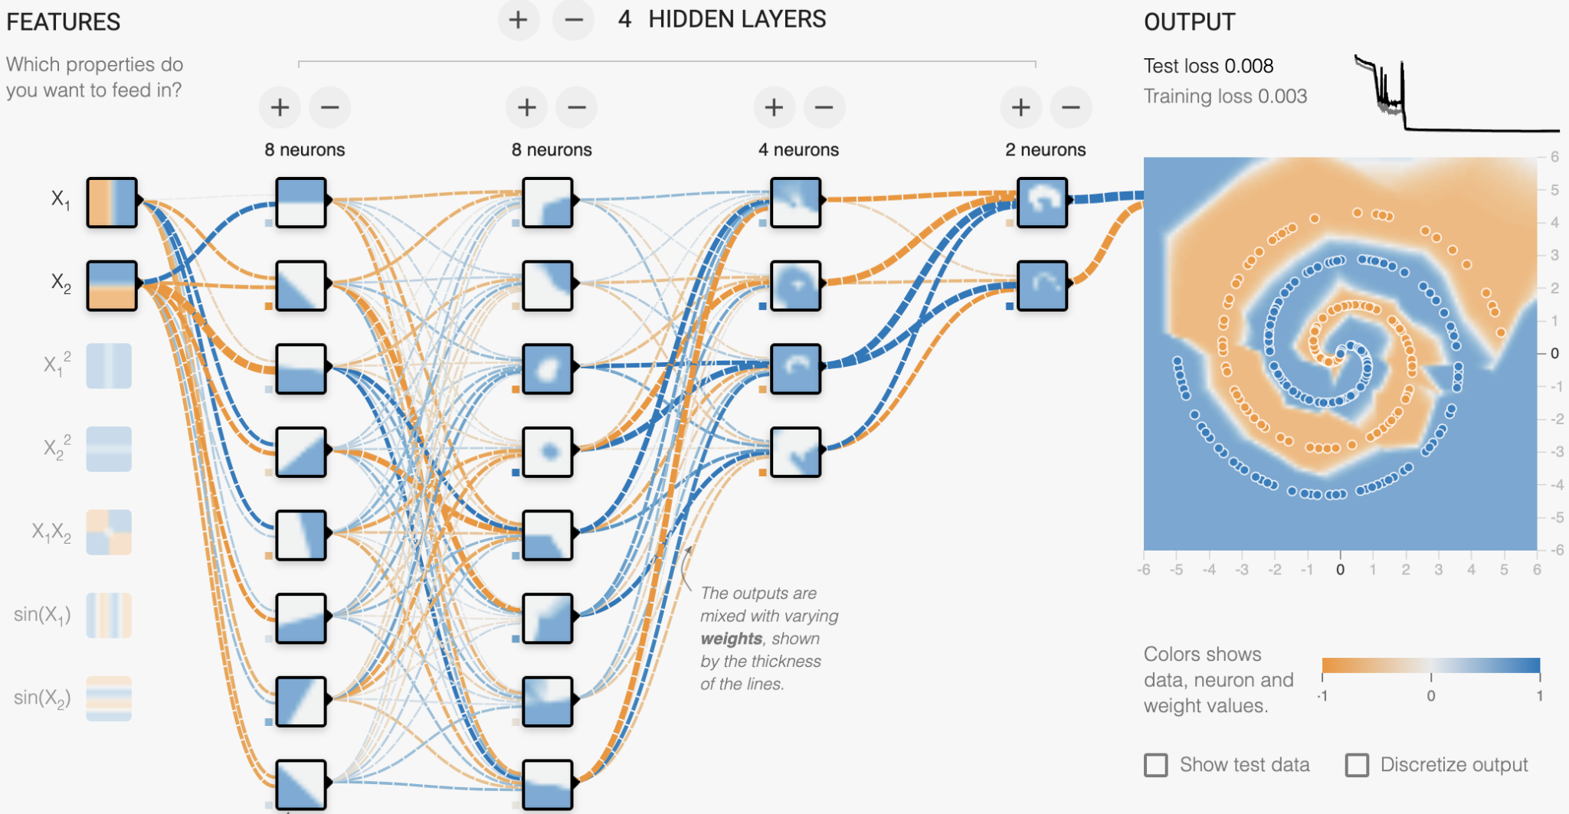
Learning Non-Linear Transformations
Notes:
complex function of 2 inputs; if you plot the values of the 4th layer neurons, they’d be linearly separable
how many parameters in this function?

Slide 7
Experimental Process
Fruit flies like a banana
Baseline
Add complexity gradually
Analyze errors
Iterate on model or data
adj noun verb det noun
System Error%
Always predict NOUN 87%
Predict most common tag 19%
State of the art 2%

Slide 8
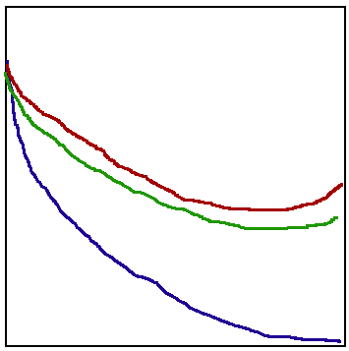
Experimental Process
Baseline
Add complexity gradually
Analyze errors
Iterate on model or data
Error rate
Test set
Dev set
Training set
Model complexity

Slide 9
Review
Notes:
Q: [True/False] It’s possible that a model that perfectly fits all the training data will still generalize well to the test data.
A: True

Slide 10
Nearest Neighbors

Slide 11
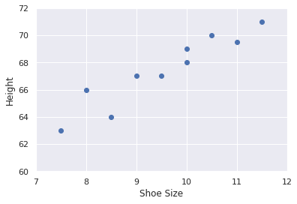
Parametric vs Non-Parametric
Parametric: model has learned parameters.
Non-parametric: no learned parameters!
Notes:
parametric regression model: y = 50 + 1.7x
non-parametric regression: the model is the training data itself

Slide 12
Nearest-Neighbor
Training: no training!
Inference:
Find the closest training example
Return its label
Notes:
[draw 2-d classification schematic with +/- labels]
complexity is hidden in the term ‘closest’
first let’s try applying NN algorithm

Slide 13
Nearest Neighbor Application
Training Data
Test Data
Age Loan Default
25 $40,000 N
35 $60,000 N
45 $80,000 N
20 $20,000 N
35 $120,000 N
40 $62,000 Y
60 $100,000 Y
48 $220,000 Y
33 $150,000 Y
Age Loan Default
31 $125,000 ?

Slide 14
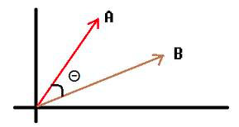
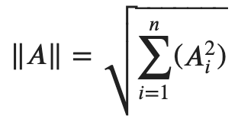
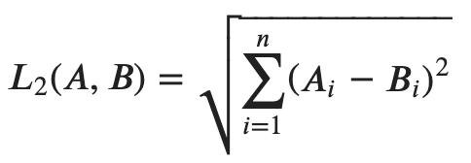
Distances

Slide 15
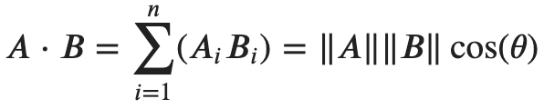
Distances
Notes:
A dot product is a measure of similarity between two vectors

Slide 16
K-Nearest Neighbors
Training: no training!
Inference:
Find the closest k training examples
Return an average over the k labels
Notes:
[draw 2-d classification schematic with +/- labels]

Slide 17
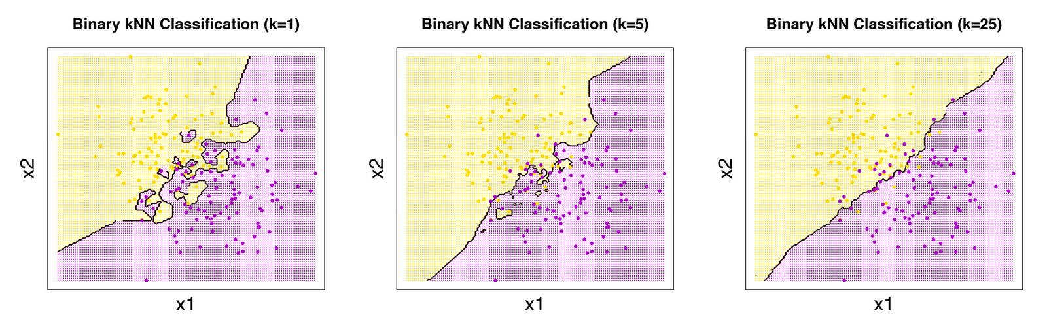
Decision Boundaries
KNN produces complex decision boundaries
Increasing K smooths the boundary

Slide 18
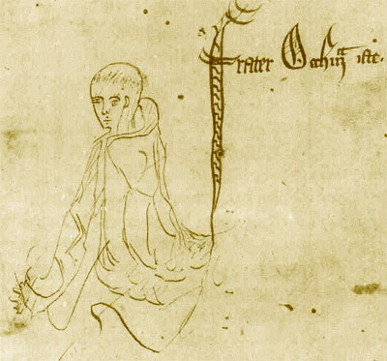
Occam’s Razor
Principle of parsimony:
Prefer the simplest explanation (fewest assumptions)
Only add complexity as necessary
[source]
Notes:
William of Ockham was a 14th century English friar and philosopher particularly concerned with logic.
The Occam’s razor maxim, as interpreted by the 20th century philosopher Bertrand Russell says that we should always opt for an explanation in terms of the fewest possible factors.
This idea is important because it addresses the central problem of machine learning: generalization.
We are always caught in between “consistency”, memorizing the details of our training data on the one hand, with “simplicity” of vast oversimplification on the other.
In general, consistency is easier to operationalize. Finding a model that fits your training data is pretty easy. But finding a simple one likely to generalize to new data is harder.

Slide 19

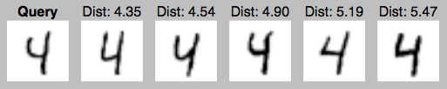
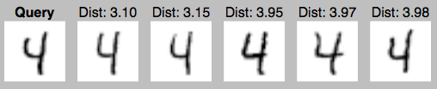
KNN for MNIST
200 training examples
1000 training examples
10000 training examples

Slide 20
KNN for MNIST
# Training Acc% Time
--------------------------
100 70.0 0.38
1000 87.9 2.34
10000 94.7 28.7
60000 97.3 2202
Experiment Settings
K=1
L2 Distance
10000 Test digits

Slide 21
KNN vs FFNN Classifiers
KNN Approach:
Use the input vector space
Many examples of each class
Apply the label from the closest example
Neural Network Approach:
The network contorts the input vector space into a new vector space
A single example of each class
Apply the label from the closest “example”

Slide 22
Nearest Neighbors
Notes:
Q: [True/False] With length-normalized vectors A and B, Euclidean distance e(A,B) is related to dot product distance d(A,B) by: e(A,B)^2/2 = 1-d(A,B)
A: True

Slide 23
Decision Trees
Notes:
Why am I telling you about nearest neighbors and decision trees? It’s interrupting the flow we were building with neural networks!
ML is a big field that spans far more than just NNs
Nearest Neighbors and Decision Trees introduce and reinforce themes that come up in many places

Slide 24
KNN Pros and Cons
Pro
Predictions are easy to understand (interpretable)
Might work with very few labeled examples
Con
Relies on a distance metric
Easily fooled by outliers (noisy training examples)
Poor scaling (slow)
Poor generalization

Slide 25
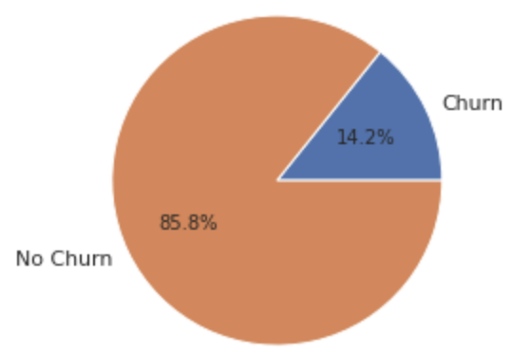
Predicting “Churn”
Telecom company data (kaggle)
Churn: cancelled contracts
Predict customers likely to churn?
Features:
International plan
Voicemail plan
Total day minutes
Total eve minutes
Total night minutes
Total intl minutes
Customer service calls
Account length

Slide 26
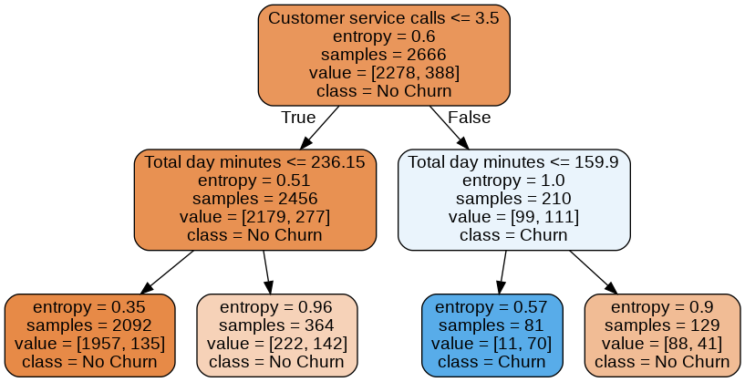
Example Decision Tree

Slide 27
Example Decision Tree
Internal Nodes: Test the value of a feature
Leaf Nodes: Output a predicted class or value

Slide 28
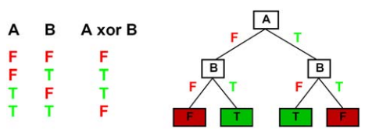
Expressiveness
Express any logical function of the features
Equivalent to a truth table for binary variables

Slide 29
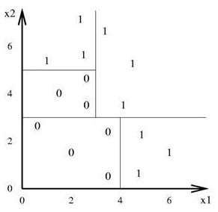
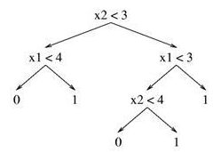
Decision Boundaries
Boundaries are rectangular partitions
Approximate diagonal lines with steps
Notes:
non-linear

Slide 30
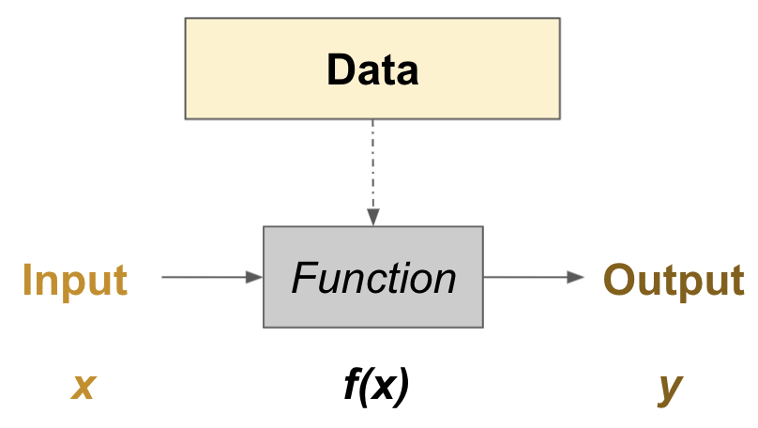
Learning for Decision Trees
Many possible trees
Balance generalization and memorization
Learned function derived from an algorithm
Like KNN, non-parametric

Slide 31
Decision Trees
Notes:
Q: [True/False] A decision tree cannot learn interactions between features.
A: False

Slide 32
Decision Tree Learning

Slide 33
Decision Tree Algorithm
def GrowTree(S):
# Base cases add a leaf.
if (y==0 for all (x,y) in S): return leaf(0)
if (y==1 for all (x,y) in S): return leaf(1)
# Add a new node.
x_j = choose_best_feature(S)
S_0 = {(x,y) in S with x_j==0}
S_1 = {(x,y) in S with x_j==1}
return node(x_j, GrowTree(S_0), GrowTree(S_1))
Examples: 100
Churn: [50, 50]
Int’l Plan?
False
True
Examples: 80
Churn: [50, 30]
Examples: 20
Churn: [0, 20]
Goal: find a (small) tree consistent with the training data
Note: greedy feature selection; when to stop growing?

Slide 34
Choosing the Next Feature
Ideal feature selection creates “pure” subsets
Need to measure “purity”
Examples: 100
Churn: [50, 50]
Int’l Plan?
Examples: 100
Churn: [50, 50]
VMail Plan?
False
True
False
True
Examples: 80
Churn: [50, 30]
Examples: 20
Churn: [0, 20]
Examples: 30
Churn: [18, 22]
Examples: 70
Churn: [32, 28]

Slide 35
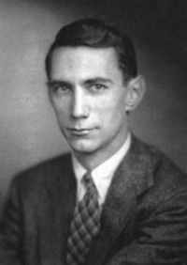
Information
Shannon’s Game
ARE WE THERE YE_
Claude Shannon
1916-2001
Notes:
Let’s take a brief detour into information theory.
Claude Shannon’s master’s thesis at MIT, written when he was 21, about digital circuits and boolean logic was probably the most import master’s thesis ever written. This work was foundational for so much computer science before there were even computers.
He is regarded as the “father of information theory”, the mathematics underlying digitally encoded messages.
And on the weekends, he and his wife used to visit Las Vegas and took home a fortune by applying game theory to blackjack. There’s a book called “Bringing Down the House”, and now a movie too, about these exploits.
Anyway, Shannon was interested in formalizing notions of uncertainty and information.
Ok so in “Shannon’s game”, the object is to predict the next character given some context.

Slide 36
Information
Shannon’s Game
ARE WE THERE YE_
How much information is conveyed by an English character?
Only one possible letter: 0 bits
27 equiprobable letters : 4.8 bits
Shannon’s estimate: ~1 bit
Information is the expected code length to convey a message
Claude Shannon
1916-2001
Notes:
Let’s take a brief detour into information theory.
Claude Shannon’s master’s thesis at MIT, written when he was 21, about digital circuits and boolean logic was probably the most import master’s thesis ever written. This work was foundational for so much computer science before there were even computers.
He is regarded as the “father of information theory”, the mathematics underlying digitally encoded messages.
And on the weekends, he and his wife used to visit Las Vegas and took home a fortune by applying game theory to blackjack. There’s a book called “Bringing Down the House”, and now a movie too, about these exploits.
Anyway, Shannon was interested in formalizing notions of uncertainty and information.
Ok so in “Shannon’s game”, the object is to predict the next character given some context.

Slide 37
Entropy
Entropy is a measure of uncertainty
More uncertainty requires longer codes (more information)
Notes:
Entropy is a measure of uncertainty, which is another way of saying information.
The more uncertainty there is about some random variable, the more information is conveyed by a value.
A uniform distribution reflects complete uncertainty, so entropy is maximized.
A distribution where one value has probability 1 reflects complete certainty, so entropy is 0.

Slide 38
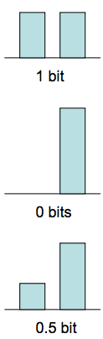
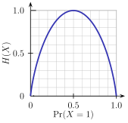
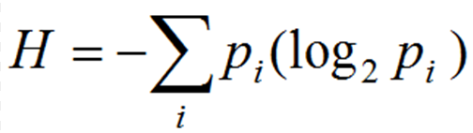
Entropy
Entropy is a measure of uncertainty
More uncertainty requires longer codes (more information)
Notes:
Entropy is a measure of uncertainty, which is another way of saying information.
The more uncertainty there is about some random variable, the more information is conveyed by a value.
A uniform distribution reflects complete uncertainty, so entropy is maximized.
A distribution where one value has probability 1 reflects complete certainty, so entropy is 0.

Slide 39


Information Gain
IG = Entropy before - Entropy after
Weighted by number of examples
IG > 0
Examples: 100
Churn: [50, 50]
Int’l Plan?
False
True
Examples: 80
Churn: [50, 30]
Examples: 20
Churn: [0, 20]
Notes:
H0 = -.5*log(.5) - .5*log(.5) = 1
H1 = -.625*log(.625) - .375*log(.375) = .95
H2 = -0*log(0) - 1*log(1) = 0
IG(Int’l Plan) = 1 - (.8*.95 + .2*0) = 1 - .76 = .24

Slide 40
Information Gain
IG = Entropy before - Entropy after
Weighted by number of examples
IG > 0
0
H₀ = -.5 log(.5)
-.5 log(.5) = 1
H₁ = -.625 log(.625)
-.375 log(.375) = .95
H₂ = -0 log(0)
-1 log(1) = 0
IG(Int’l Plan) =
1 - [.8(.95) + .2(0)] =
1 - .76 =
.24
Examples: 100
Churn: [50, 50]
Int’l Plan?
False
True
1
2
Examples: 80
Churn: [50, 30]
Examples: 20
Churn: [0, 20]
Notes:
H0 = -.5*log(.5) - .5*log(.5) = 1
H1 = -.625*log(.625) - .375*log(.375) = .95
H2 = -0*log(0) - 1*log(1) = 0
IG(Int’l Plan) = 1 - (.8*.95 + .2*0) = 1 - .76 = .24

Slide 41
Information Gain
Examples: 100
Churn: [50, 50]
Int’l Plan?
Examples: 100
Churn: [50, 50]
VMail Plan?
False
True
False
True
Examples: 80
Churn: [50, 30]
Examples: 20
Churn: [0, 20]
Examples: 40
Churn: [15, 25]
Examples: 60
Churn: [35, 25]
IG = 0.24
IG = 0.03

Slide 42
Decision Tree Learning
Notes:
Q: [True/False] The decision tree algorithm finds the optimal tree (the smallest tree that explains the training data).
A: False

Slide 43
Decision Tree Example

Slide 44
Non-Binary Features
Categorical features
Convert to binary (as before)
Or use higher branching factor
Numerical features
Choose a split point (threshold)
Using information gain
Note: no normalization necessary!

Slide 45
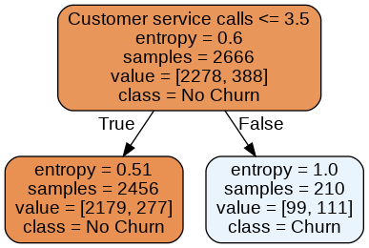
Depth 1
Depth Train AP Test AP
1 0.2551 0.2366
Notes:
decision stump (single feature)
output classes vs probabilities

Slide 46
Depth 2
Depth Train AP Test AP
1 0.2551 0.2366
2 0.4275 0.4622

Slide 47
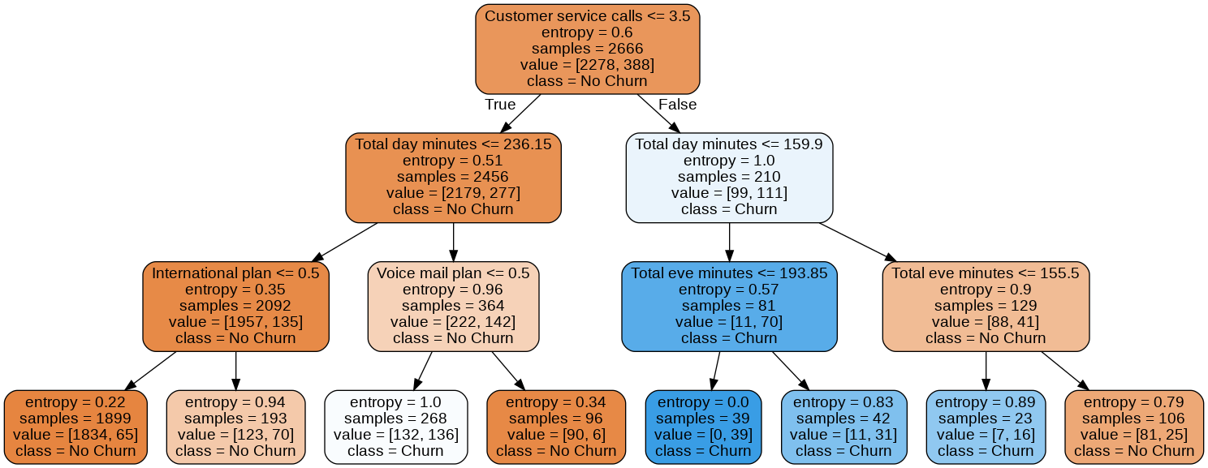
Depth 3
Depth Train AP Test AP
1 0.2551 0.2366
2 0.4275 0.4622
3 0.5674 0.5558
Notes:
pure subset -- leaf node

Slide 48
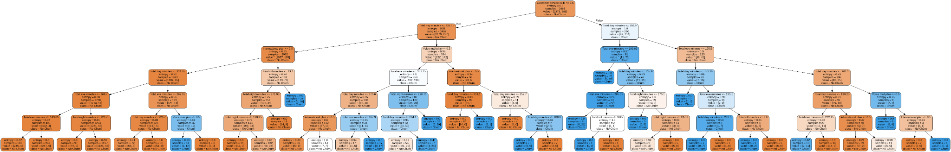
Depth k
Depth Train AP Test AP
1 0.2551 0.2366
2 0.4275 0.4622
3 0.5674 0.5558
4 0.7149 0.7001
5 0.7893 0.7527
6 0.8361 0.7709
7 0.8631 0.7097
8 0.8910 0.6465

Slide 49
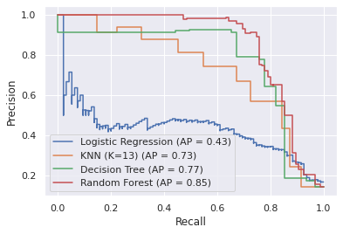
Model Comparison
Model Test AP
Predict No Churn 0.1424
Logistic Regression (Z-Norm) 0.4334
KNN (K=1) 0.2165
KNN (K=1; Z-norm) 0.4059
KNN (K=13; Z-norm) 0.7321
Decision Tree (Depth 6) 0.7709
Random Forest 0.8514

Slide 50
Regression Trees
Use MSE, comparing average node output with the target values
Examples: 100
Minutes: 123.8
Int’l Plan?
False
True
Examples: 80
Minutes: 119.3
Examples: 20
Minutes: 141.6

Slide 51
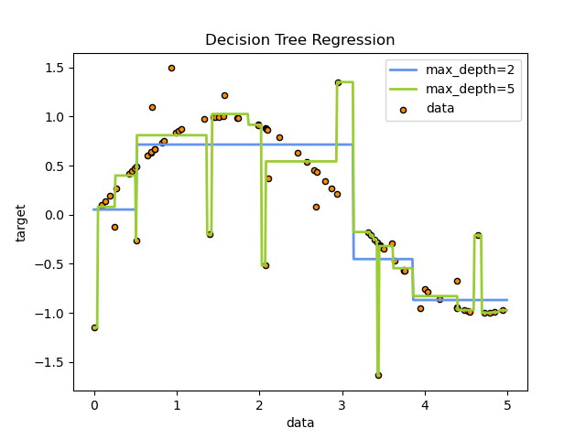
Regression Trees
Notes:
[build depth 2 tree]: x1<3.2 -> (x1<0.5; x1<3.8)

Slide 52
Decision Tree Example
Notes:
Q: [True/False] A decision tree will always be a balanced binary tree.
A: False

Slide 53
Trees to Forests

Slide 54
Decision Tree Pros and Cons
Pro
Emulates human descriptions of decision logic
Arbitrary complexity (non-linear functions)
Minimal pre-processing and scaling
Con
Greedy search is non-optimal
Poor generalization

Slide 55
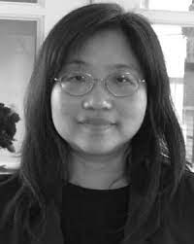
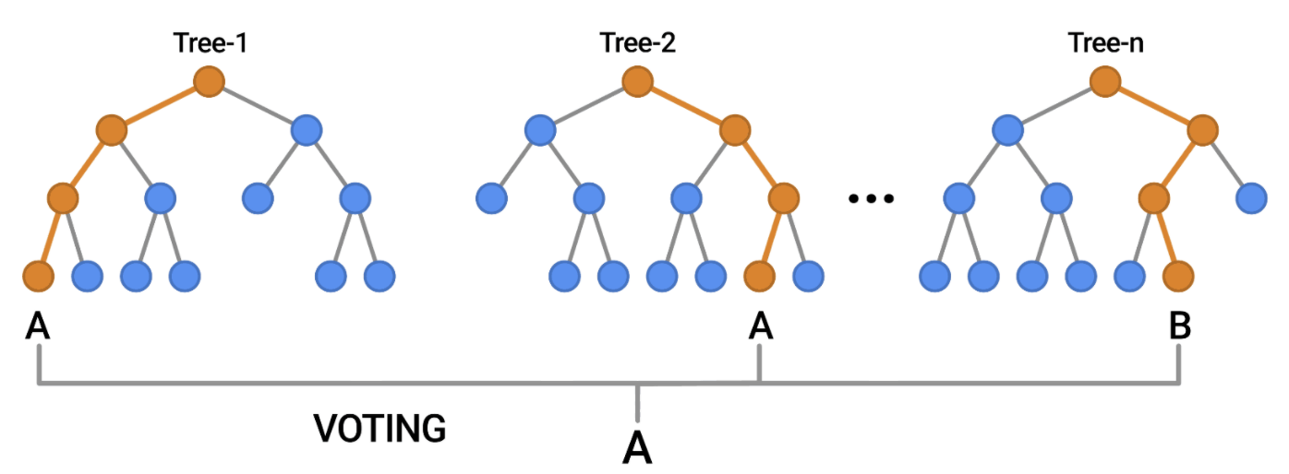
Random Forest
Build k decision trees
Use each tree to predict an output
Take a vote
Tin Kam Ho
[source]
Notes:
Ensembles usually work better than a single classifier, but the individual classifiers need to be different

Slide 56
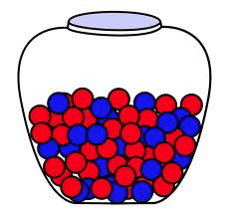
Random Forest
Sources of randomness:
Random sampling of training examples
Random subset of features
Important hyper-parameters:
Number of trees
Maximum tree depth
bootstrap sampling: sample training examples with replacement

Slide 57
Gradient Boosting
data (x, y)
r1 = y’ - y

Slide 58
Gradient Boosting
data (x, y)
data (x, r1)
r1 = y’ - y
r2 = r1’ - r1

Slide 59
Gradient Boosting
data (x, y)
data (x, r1)
data (x, r2)
r1 = y’ - y
r2 = r1’ - r1
r3 = r2’ - r2

Slide 60
Ensemble Methods
f1
Bagging: train models in parallel via bootstrap sampling
f2
f3

Slide 61
Ensemble Methods
f1
Bagging: train models in parallel via bootstrap sampling
Boosting: train additive models in series where each predicts the residual from the previous model
f2
f3
f1
f2
f3

Slide 62
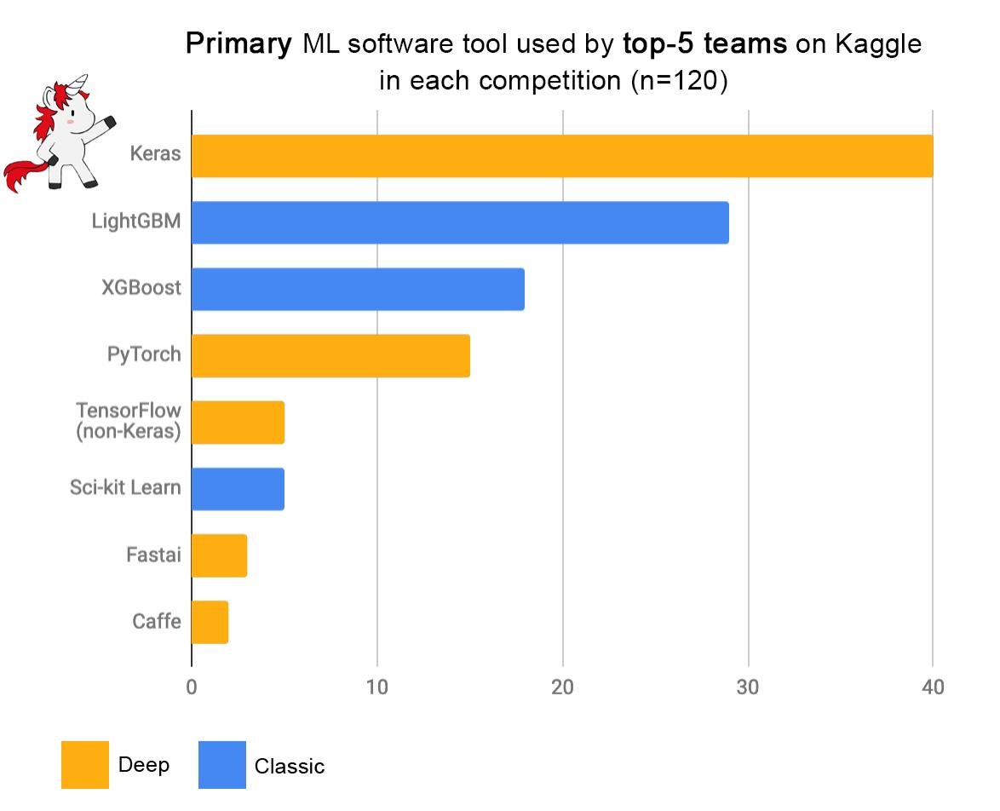
Decision Trees in Practice
Neural Networks
Gradient Boosted Decision Trees
[source]

Slide 63
Trees to Forests
Notes:
Q: [True/False] Bagging and boosting can be used with any classifier.
A: True

